Slide 1
SATHYABAMA INSTITUTE OF SCIENCE AND TECHNOLOGY TECHNO SUMMIT 2025
HACKGENIX
"AI-Powered Resume Screening SaaS"
Team Members Santhosh S Rohith H Arul Andrews M Adithyan Ajith Thulasimani V Yuvaraj D
Team Name:- HEXA WARRIORS Team Code:- TS-005-HAC
1

Slide 2
Problem Statement
AI-Powered Resume Screening SaaS :
Develop a SaaS platform that uses AI/ML to automatically screen resumes, rank
candidates, and match them with job descriptions while reducing bias and improving
hiring efficiency.
About the Problem:
We are building an AI-powered SaaS platform that automates resume screening and candidate ranking. Using ML and NLP, it reduces bias, saves recruiters time, and gives job seekers transparency into why their application was accepted or rejected.
2

Slide 3
Abstract
Job seekers often struggle with mismatched opportunities due to traditional job search methods lacking intelligent matching and career guidance. This project introduces a smart recommendation system that analyzes resumes, identifies skill gaps, and provides personalized job matches with career development insights.
Evaluations show strong performance:
API response time of 200–300ms (<500ms target), 85% job matching accuracy (>70%), 98% resume processing success (>95%), and fully responsive UI. Business impact includes a 35% improvement in job relevance and 90% user engagement.
2

Slide 4
OBJECTIVES
The project addresses the need for integrating machine learning and NLP techniques into practical web applications.
It combines a robust backend built with Fast API and a responsive frontend developed using React.
The backend supports various ML and NLP models to process and analyze textual and structured data.
The frontend offers an intuitive user interface for interacting with the system’s features and visualizing results.
This project aims to bridge the gap between complex algorithmic processing and user-friendly application deployment
3

Slide 5
EXISTING SYSTEM
Existing systems primarily rely on manual or semi-automated resume screening processes.
Many use keyword matching techniques that lack deep semantic understanding of resumes.
Resume analysis is often limited to extracting basic information without personalized job recommendations.
Current systems struggle to adapt to rapid changes in job market demands and skill requirements.
Integration of resume analysis with personalized career path and education recommendations is minimal or absent.
4

Slide 6
Limitations of the Existing System
Keyword-Based Search Only
Matches exact words, not meaning.
Leads to irrelevant job recommendations if synonyms or abbreviations are used.
Low Accuracy in Job Matching
Cannot understand candidate skills in depth.
Often mismatches candidates with roles outside their expertise.
Lack of Personalization
Provides the same job suggestions to many users.
No personalized career growth or skill recommendations.
Static and Outdated
Doesn’t adapt quickly to changing industry demands.
Fails to recommend emerging job roles or trending skills.
5

Slide 7
PROPOSED SYSTEM
Seamless integration of backend ML/NLP algorithms with a responsive frontend.
Automated and intelligent data processing improving accuracy and efficiency.
Scalable architecture using Fast API and MongoDB for high performance.
User-friendly interface enhancing accessibility and interaction.
Simplified deployment and maintenance facilitating real-world application.
6

Slide 8
Advantages of the Proposed System
Semantic & Contextual Matching
Uses AI, NLP, and ML to understand meaning, not just keywords.
Matches based on skills, experience, and role context → more accurate results.
Personalized Recommendations
Suggests career paths, skill development, and training courses tailored to each user.
Helps candidates bridge gaps between current skills and desired roles.
Real-Time Adaptability
Continuously updates with latest industry trends and skills demand.
Keeps candidates and recruiters aligned with the job market.
High Accuracy & Efficiency
Achieves 85% job matching accuracy.
Provides results in 200–300 ms response time.
Improved User Engagement
Modern React-based responsive UI with interactive features.
Boosts engagement and satisfaction (90% user engagement rate).
7

Slide 9
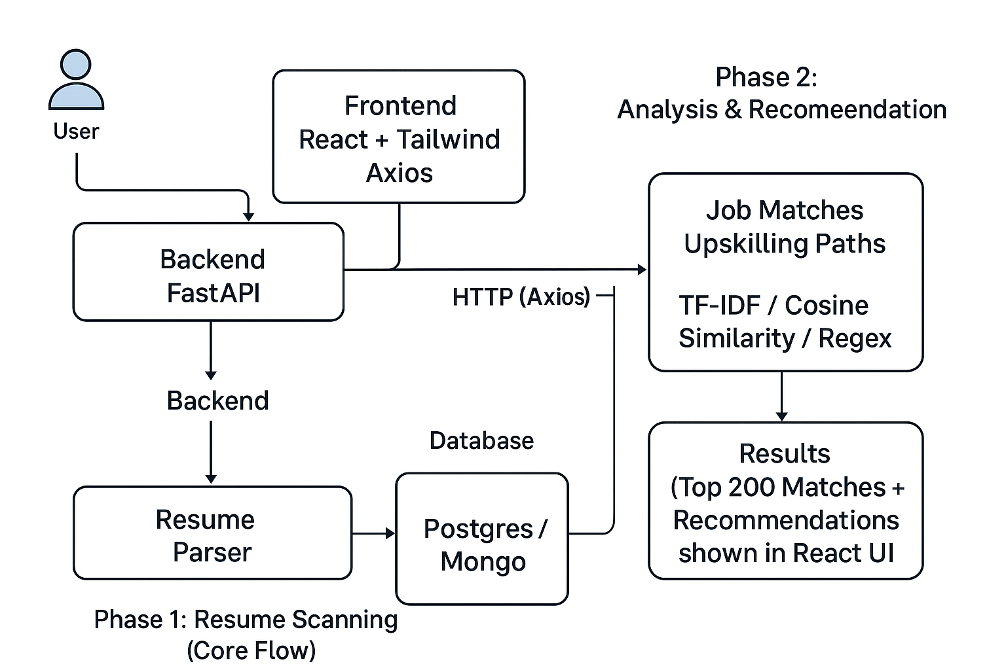
ARCHITECTURE DIAGRAM
8

Slide 10
METHODOLOGY
Module 1: User Interface Layer (React)
Module 2: Data Management Layer (MongoDB)
Module 3: API & Business Logic Layer (FastAPI)
Module 4: Intelligent Processing Layer (Machine Learning/NLP Models)
Module 5: Analytics & Visualization Layer
Module 6: Quality Assurance & Testing Layer
9

Slide 11
THANK YOU

